Slide 1
Algorithms and Data Structures
Almaz Turginbekov
MSc in Computer Science and Engineering
Graduate School of Science and Technology
Niigata University
Teacher East-Kazakhstan Technical University

Slide 2
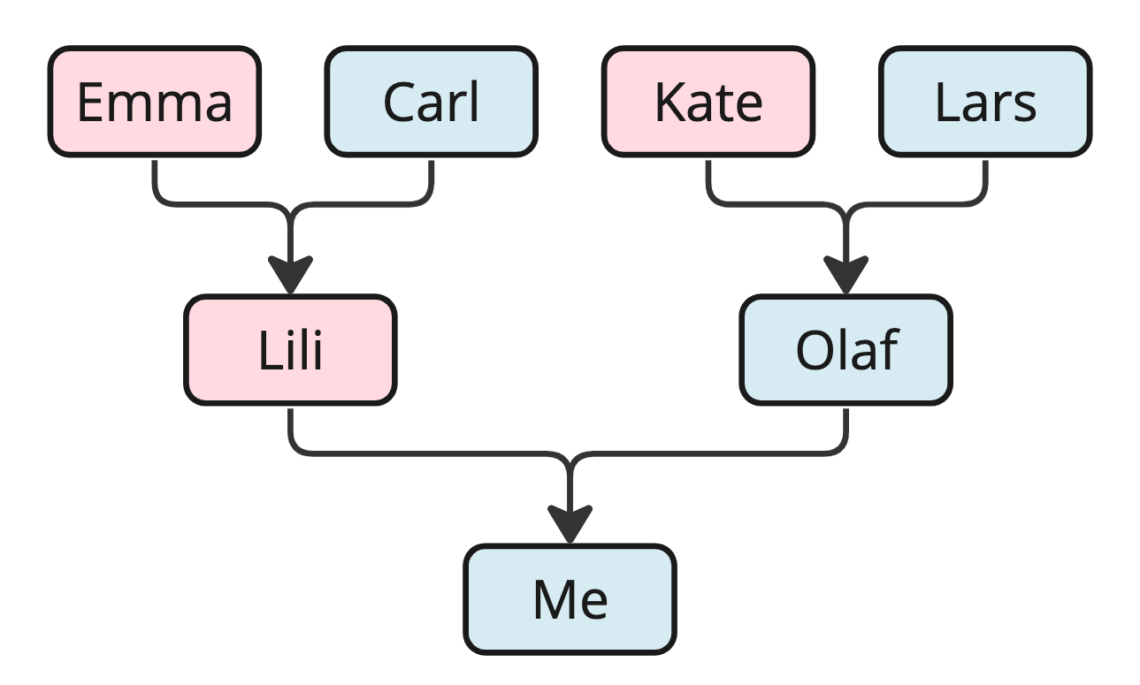
What are Data Structures?
A data structure is a way to store data.
We structure data in different ways depending on what data we have, and what we want to do with it.
Data structures give us the possibility to manage large amounts of data efficiently for uses such as large databases and internet indexing services.
Data structures are essential ingredients in creating fast and powerful algorithms. They help in managing and organizing data, reduce complexity, and increase efficiency.
Notes:
First, let's consider an example without computers in mind, just to get the idea.
If we want to store data about people we are related to, we use a family tree as the data structure. We choose a family tree as the data structure because we have information about people we are related to and how they are related, and we want an overview so that we can easily find a specific family member, several generations back.
With such a family tree data structure visually in front of you, it is easy to see, for example, who my mother's mother is-it is 'Emma,' right? But without the links from child to parents that this data structure provides, it would be difficult to determine how the individuals are related.

Slide 3
What are Data Structures? [2]
In Computer Science there are two different kinds of data structures.
Primitive Data Structures are basic data structures provided by programming languages to represent single values, such as integers, floating-point numbers, characters, and booleans.
Abstract Data Structures are higher-level data structures that are built using primitive data types and provide more complex and specialized operations. Some common examples of abstract data structures include arrays, linked lists, stacks, queues, trees, and graphs.

Slide 4
What are Algorithms?
An algorithm is a set of step-by-step instructions to solve a given problem or achieve a specific goal.
Algorithms are fundamental to computer programming as they provide step-by-step instructions for executing tasks. An efficient algorithm can help us to find the solution we are looking for, and to transform a slow program into a faster one.
Algorithm examples:
  Finding the fastest route in a GPS navigation system
  Navigating an airplane or a car (cruise control)
  Finding what users search for (search engine)
  Sorting, for example sorting movies by rating

Slide 5
Data Structures together with Algorithms
Data structures and algorithms (DSA) go hand in hand. A data structure is not worth much if you cannot search through it or manipulate it efficiently using algorithms, and the algorithms in this tutorial are not worth much without a data structure to work on.
DSA is about finding efficient ways to store and retrieve data, to perform operations on data, and to solve specific problems.
By understanding DSA, you can:
  Decide which data structure or algorithm is best for a given situation.
  Make programs that run faster or use less memory.
  Understand how to approach complex problems and solve them in a systematic way.

Slide 6
Where is Data Structures and Algorithms Needed?
Data Structures and Algorithms (DSA) are used in virtually every software system, from operating systems to web applications:
  For managing large amounts of data, such as in a social network or a search engine.
  For scheduling tasks, to decide which task a computer should do first.
  For planning routes, like in a GPS system to find the shortest path from A to B.
  For optimizing processes, such as arranging tasks so they can be completed as quickly as possible.
  For solving complex problems: From finding the best way to pack a truck to making a computer 'learn' from data.

Slide 7
Where is Data Structures and Algorithms Needed?
DSA is fundamental in nearly every part of the software world:
  Operating Systems
  Database Systems
  Web Applications
  Machine Learning
  Video Games
  Cryptographic Systems
  Data Analysis
  Search Engines

Slide 8
Theory and Terminology
Term | Description
Algorithm | A set of step-by-step instructions to solve a specific problem.
Data Structure | A way of organizing data so it can be used efficiently. Common data structures include arrays, linked lists, and binary trees.
Time Complexity | A measure of the amount of time an algorithm takes to run, depending on the amount of data the algorithm is working on.
Space Complexity | A measure of the amount of memory an algorithm uses, depending on the amount of data the algorithm is working on.
Big O Notation | A mathematical notation that describes the limiting behavior of a function when the argument tends towards a particular value or infinity. Used in this tutorial to describe the time complexity of an algorithm.
Recursion | A programming technique where a function calls itself.
Divide and Conquer | A method of solving complex problems by breaking them into smaller, more manageable sub-problems, solving the sub-problems, and combining the solutions. Recursion is often used when using this method in an algorithm.
Brute Force | A simple and straight forward way an algorithm can work by simply trying all possible solutions and then choosing the best one.

Slide 9
Time Coplexity
Runtime
To fully understand algorithms we must understand how to evaluate the time an algorithm needs to do its job, the runtime.
Exploring the runtime of algorithms is important because using an inefficient algorithm could make our program slow or even unworkable.
By understanding algorithm runtime we can choose the right algorithm for our need, and we can make our programs run faster and handle larger amounts of data effectively.

Slide 10
Time Coplexity
Actual Runtime
When considering the runtime for different algorithms, we will not look at the actual time an implemented algorithm uses to run, and here is why.
If we implement an algorithm in a programming language, and run that program, the actual time it will use depends on many factors:
  the programming language used to implement the algorithm
  how the programmer writes the program for the algorithm
  the compiler or interpreter used so that the implemented algorithm can run
  the hardware on the computer the algorithm is running on
  the operating system and other tasks going on on the computer
  the amount of data the algorithm is working on
With all these different factors playing a part in the actual runtime for an algorithm, how can we know if one algorithm is faster than another? We need to find a better measure of runtime.

Slide 11
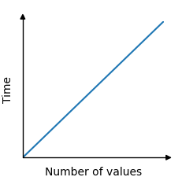
Time Coplexity
To evaluate and compare different algorithms, instead of looking at the actual runtime for an algorithm, it makes more sense to use something called time complexity.
Time complexity is more abstract than actual runtime, and does not consider factors such as programming language or hardware.
Time complexity is the number of operations needed to run an algorithm on large amounts of data. And the number of operations can be considered as time because the computer uses some time for each operation.
For example, in the algorithm that finds the lowest value in an array, each value in the array must be compared one time. Every such comparison can be considered an operation, and each operation takes a certain amount of time. So the total time the algorithm needs to find the lowest value depends on the number of values in the array.
The time it takes to find the lowest value is therefore linear with the number of values. 100 values results in 100 comparisons, and 5000 values results in 5000 comparisons.
The relationship between time and the number of values in the array is linear, and can be displayed in a graph like this:

Slide 12
Big O Notation
In mathematics, Big O notation is used to describe the upper bound of a function.
In computer science, Big O notation is used more specifically to find the worst case time complexity for an algorithm.
Big O notation uses a capital letter O with parenthesis O(), and inside the parenthesis there is an expression that indicates the algorithm runtime. Runtime is usually expressed using n, which is the number of values in the data set the algorithm is working on.

Slide 13
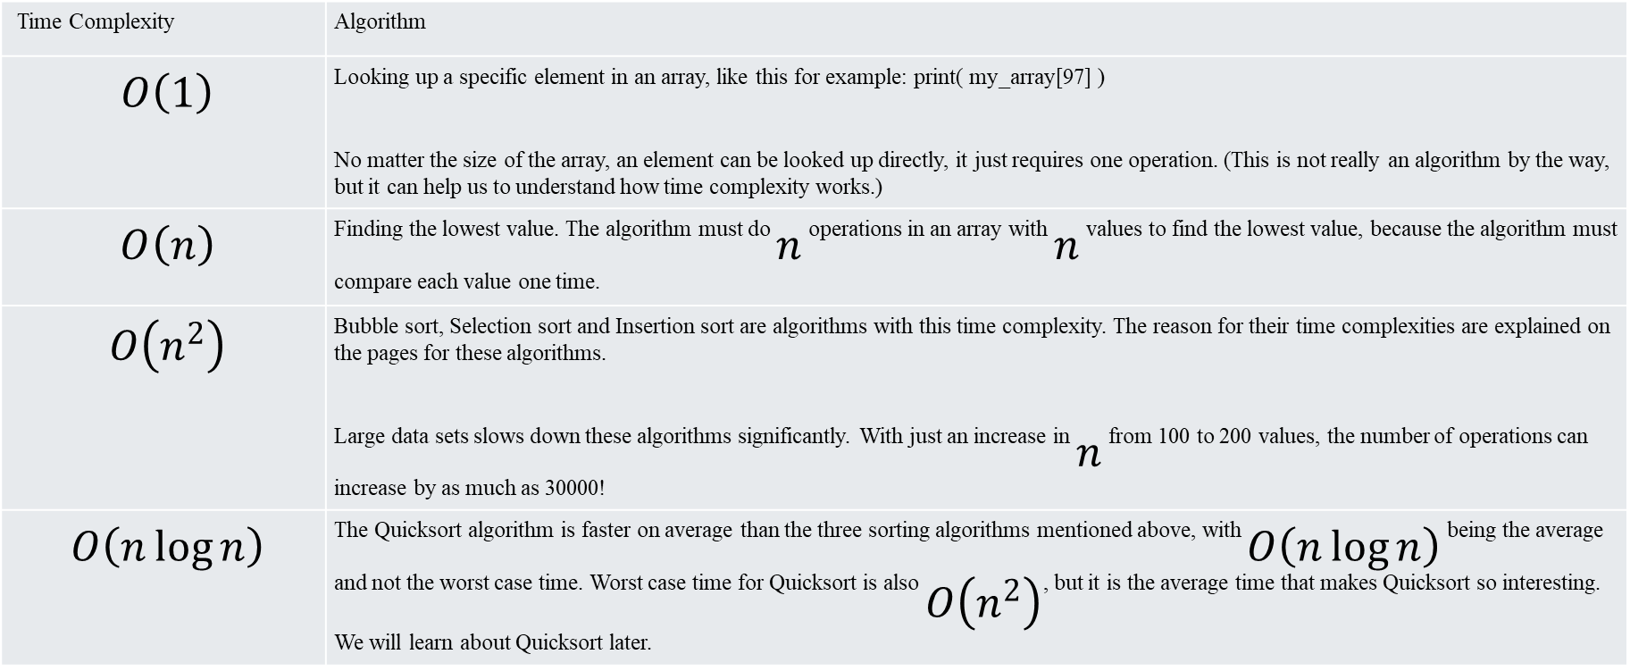
Big O Notation
Time Complexity | Algorithm
$$O\left(1\right)$$ | Looking up a specific element in an array, like this for example: print( my_array[97] ) No matter the size of the array, an element can be looked up directly, it just requires one operation. (This is not really an algorithm by the way, but it can help us to understand how time complexity works.)
$$O\left(n\right)$$ | Finding the lowest value. The algorithm must do $n$ operations in an array with $n$ values to find the lowest value, because the algorithm must compare each value one time.
$$O\left(n^{2}\right)$$ | Bubble sort, Selection sort and Insertion sort are algorithms with this time complexity. The reason for their time complexities are explained on the pages for these algorithms. Large data sets slows down these algorithms significantly. With just an increase in $n$ from 100 to 200 values, the number of operations can increase by as much as 30000!
$$O\left(n\log{n}\right)$$ | The Quicksort algorithm is faster on average than the three sorting algorithms mentioned above, with $O\left(n\log{n}\right)$ being the average and not the worst case time. Worst case time for Quicksort is also $O\left(n^{2}\right)$, but it is the average time that makes Quicksort so interesting. We will learn about Quicksort later.

Slide 14
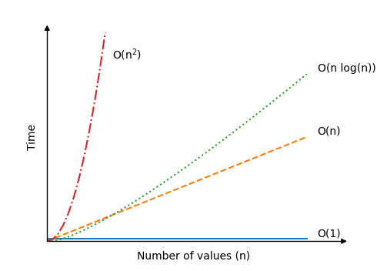
Big O Notation

Slide 15
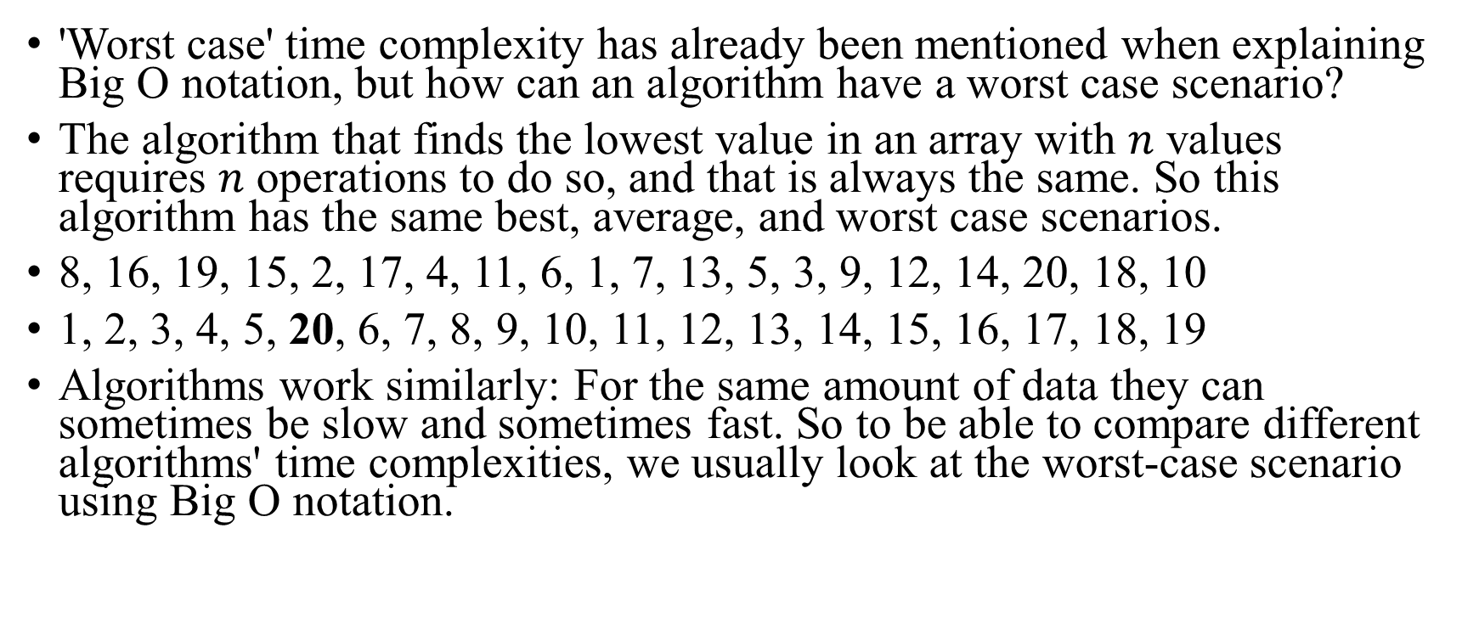
Best, Average and Worst Case
'Worst case' time complexity has already been mentioned when explaining Big O notation, but how can an algorithm have a worst case scenario?
The algorithm that finds the lowest value in an array with $n$ values requires $n$ operations to do so, and that is always the same. So this algorithm has the same best, average, and worst case scenarios.
8, 16, 19, 15, 2, 17, 4, 11, 6, 1, 7, 13, 5, 3, 9, 12, 14, 20, 18, 10
1, 2, 3, 4, 5, 20, 6, 7, 8, 9, 10, 11, 12, 13, 14, 15, 16, 17, 18, 19
Algorithms work similarly: For the same amount of data they can sometimes be slow and sometimes fast. So to be able to compare different algorithms' time complexities, we usually look at the worst-case scenario using Big O notation.

Slide 16
Example 1
O(1)
  def get_first_item(data):
  print(data[0])
  scores = [95, 42, 88, 100, 75]
  get_first_item(scores)

Slide 17
Example 2
O(n)
  def find_minimum(data):
  min_value = data[0]
  for value in data:
  if value < min_value:
  min_value = value
  return min_value

Slide 18
Example 3
O(n^2)
def check_duplicates(data):
n = len(data)
operations_count = 0
for i in range(n): #N times
for j in range(n): # N Times → n*n = n^2
operations_count += 1
if i != j and data[i] == data[j]:
print(f“Same operation: {data[i]}")
print(f“Total: {operations_count}")

